Slide 1

Plenary Session III
21st Century Risk Assessment Academic Perspective
Elaine M. Faustman, Ph.D. DABT
Professor and Director
Institute for Risk Analysis and Risk Communication
Department of Environmental and Occupational Health Sciences

Slide 2
Timothy W. Gant, Guest Editor

Slide 3
“The toxicologist of the 21st Century is going to need to be a very multiskilled individual. Are our universities meeting this challenge?” T.W. Gant

Slide 4
Characteristics of Effective Training Programs
Multidisciplinary
Broad training base (degree and program options)
Diverse faculty base
Curriculum Flexibility
Electives – Options encouraged special topics

Slide 5
Risk Assessment and Systems Based Approaches Provide a Robust Platform for Training

Slide 6
Example integration of Tox 21 training and database utilization within Academic Community
Focus of Thesis projects
Tool within Thesis projects
Special Topics webinars

Slide 7
Journal Club
ToxCast
ToxRefDB
EPA’s ExpoCast
EPA’s EJSCREEN

Slide 8

Using federally funded tools for toxicological prioritization of the data from Washington State’s Children’s Safe Product Act
Marissa N. Smith, Elaine M. Faustman and Joshua Grice

Slide 9
Children’s Safe Product Act
CSPA was passed in 2008 in Washington State. It requires that manufactures of children’s products report whether specific Chemicals of High Concern to Children are present in their products and at which concentration range.
While this requirement has successfully generated an extensive database, information regarding the potential route of exposure and mechanism of toxicity has not been integrated
In this project we created an integrating framework for a toxicological interpretation of the most frequently reported CSPA chemicals.
The framework for the toxicological interpretation of the CSPA data is based on the following variables: Lifestage Concerns, Product Accessibility, Exposure Duration, Chemical Concentration, Chemical Properties, Toxicokinetics, and Systemic Toxicity Endpoints

Slide 10
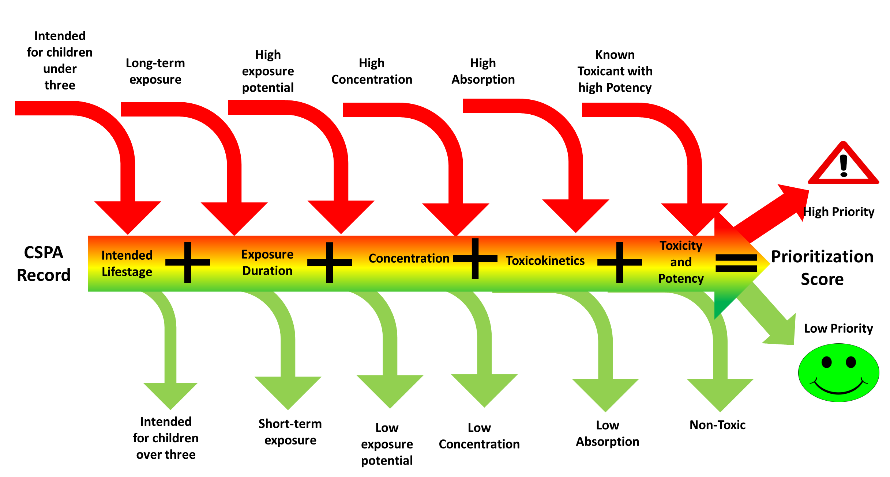
Basic Toxicological Framework
ASTDR
Toxnet
IARC
GHS
REACH
EPA IRIS

Slide 11
Challenges for Academic Programs
Some Academic programs have inflexible curriculum (eg Medical schools)
Training programs are often targeted by discipline or disease –Example exceptions are Superfund, Environmental Pathology/Toxicology training programs
Lack of funding for multidisciplinary efforts especially if they go across programs, schools and universities
Targeted workshops are useful tools but frequently lack integration

Slide 12
Timothy W. Gant, Guest Editor

Slide 13
Acknowledgements
Funding: Thank you to the FDA (1U01FD004242-01),
Children’s Environmental Health Risks Research Center
NIEHS (5 P01 ES009601) and EPA (RD-83170901),
EPA Predictive Toxicology Center (RD-83573801),
and NIEHS Environmental Pathology/Toxicology Training Grant (ES07032)

